Slide 1
PRESENTATION ON BIKES AND SCOOTER RENTAL SYSTEM
SUBMITTED BY:- RUSHALI R. PENDURKAr Krupa h. gala.

Slide 2
PROJECT GOAL
This application provide a web-based system that allow customer to register the bikes and scooter.
To ease customer’s task whenever they need to rent a bikes.

Slide 3
OBJECTIVE
1.ADMIN:-
To login into site.
To manage the user requests.
Admin will get reports.
2.USER:-
To do registration into site.
To enter his/her details and login into website.
User can cancel their bookings if they don’t want.
User will get reports.

Slide 4
Scope
PHP technology used for the development of the application.
It increases the efficiency of the management at offering quality services to the customers.
It provides custom features development and support with the software.

Slide 5
PLATFORM ENVIRONMENT
Frontend:-PHP (version 5.4.16)
Backend:-MYSQL(version 2.0.0)

Slide 6
SYSTEM REQUIREMENT ANALYSIS
MODULES
ADMIN
USER
ADMIN MODULE:-
Login
To do login
Booking
Bookings can be done
Insert and update
Insert vehicles
Update vehicles
Report
Admin will get reports

Slide 7
USER MODULE:-Login
User can login
Booking
User can do bookings
Registration form
User can register
Report
User will get re

Slide 8
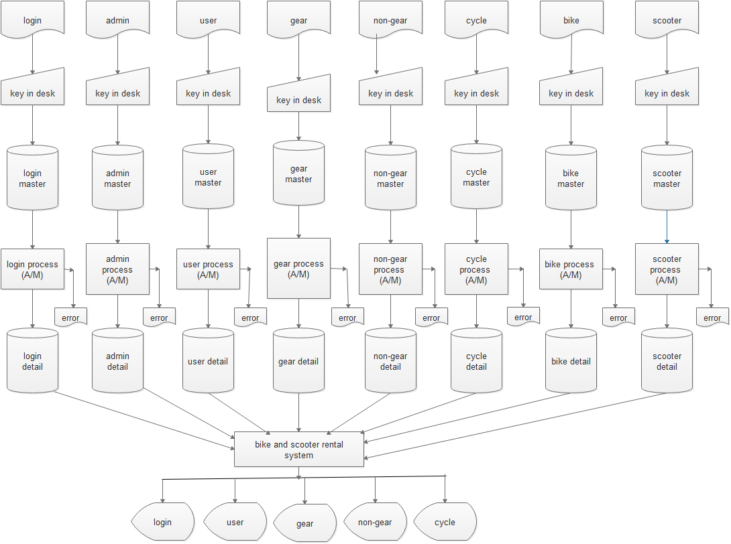
SFD

Slide 9
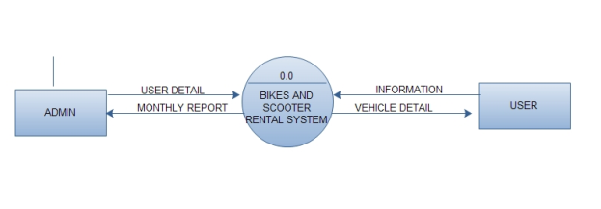
DFD(0 LEVEL)

Slide 10
1 LEVEL DFD

Slide 11
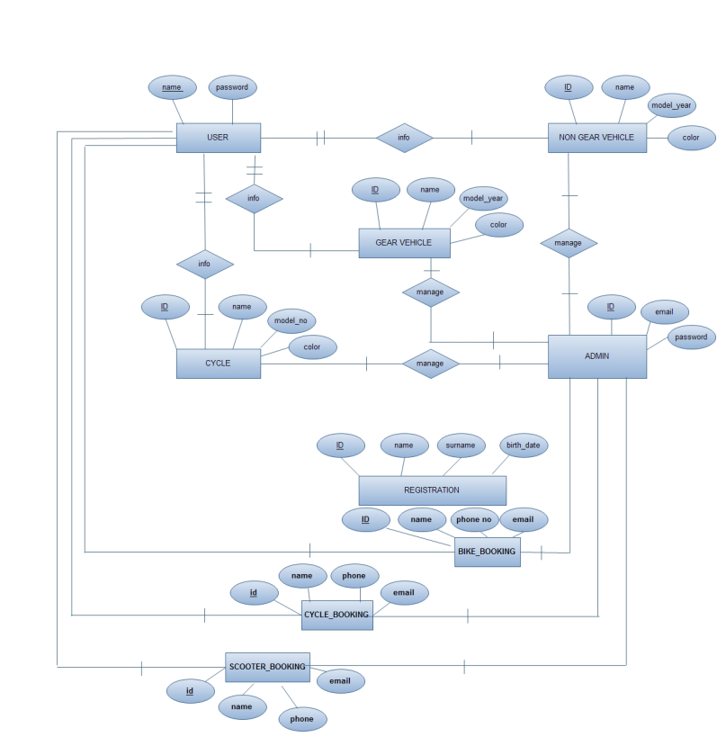
ER-DIAGRAM

Slide 12
USER-REGISTRATION
Field name | Type | Width | Constraints | Description
ID | Int | 3 | Primary key | User_id
Name | Varchar | 20 | Not null | User_name
Surname | Varchar | 20 | Not null | User_surname
Bday | Date | - | Not null | User_bday
Age | Int | 3 | Not null | User_age
Gender | Varchar | 8 | Not null | User_gender
Address | Varchar | 60 | Not null | User_add
City | Varchar | 20 | Not null | User_city
State | Varchar | 20 | Not null | User_state
Country | Varchar | 20 | Not null | User_coun
Pincode | Int | 10 | Not null | User_pin
Email_id | Varchar | 30 | Not null | User_email
Password | Varchar | 30 | Not null | User_pass

Slide 13
DATA DICTIONARY
LOGIN
Field name | Type | Width | Description
Email | Varchar | 30 | User_email
Password | Varchar | 30 | User_pass

Slide 14
CYCLE
Field name | Type | Width | Constraints | Description
ID | Float | 3 | Primary key | Cyc_id
Name | varchar | 20 | Not null | Cyc _name
Color | varchar | 20 | Not null | Cyc _color
3-Hrs | Int | 5 | Not null | Cyc _price
4-Hrs | Int | 5 | Not null | Cyc _price
5-Hrs | Int | 5 | Not null | Cyc _price
1-Day | Int | 5 | Not null | Cyc _price
2-Days | Int | 5 | Not null | Cyc _price
3-Days | Int | 5 | Not null | Cyc _price
4-Days | Int | 5 | Not null | Cyc _price
5-Days | Int | 5 | Not null | Cyc _price

Slide 15
GEAR VEHICLE
Field name | Type | Width | Constraints | Description
ID | Float | 3 | Primary key | Vehi_id
Name | Varchar | 20 | Not null | Vehi_name
Model_year | Int | 5 | Not null | Vehi_year
Color | Varchar | 20 | Not null | Vehi_color
3-Hrs | Int | 5 | Not null | Vehi_price
4-Hrs | Int | 5 | Not null | Vehi_price
5-Hrs | Int | 5 | Not null | Vehi_price
1-Day | Int | 5 | Not null | Vehi_price
2-Days | Int | 5 | Not null | Vehi_price
3-Days | Int | 5 | Not null | Vehi_price
4-Days | Int | 5 | Not null | Vehi_price
5-Days | Int | 5 | Not null | Vehi_price

Slide 16
NON GEAR VEHICLE
Field name | Type | Width | Constraints | Description
ID | Float | 3 | Primary key | Vehi_id
Name | Varchar | 20 | Not null | Vehi_name
Model_year | Int | 5 | Not null | Vehi_year
Color | Varchar | 20 | Not null | Vehi_color
3-Hrs | Int | 5 | Not null | Vehi_price
4-Hrs | Int | 5 | Not null | Vehi_price
5-Hrs | int | 5 | Not null | Vehi_price
1-Day | int | 5 | Not null | Vehi_price
2-Days | int | 5 | Not null | Vehi_price
3-Days | int | 5 | Not null | Vehi_price
4-Days | int | 5 | Not null | Vehi_price
5-Days | int | 5 | Not null | Vehi_price

Slide 17
bike booking
Field Name | Type | Width | Constraints | Description
Sr.no | Int | 5 | Primary key | Sr_no
Name | Varchar | 30 | Not null | User_name
Phone_no | Int | 10 | Not null | Bike_phone_n0
Email_id | Varchar | 30 | Not null | Bike_email_id
Bike_id | Float | 0.1 | Not null | Bike_id
Bike_name | Varchar | 30 | Not null | Bike_name
Model_year | Int | 5 | Not null | Bike_mode_ year
Color | Varchar | 20 | Not null | Bike_color
Date | Date |  | Not null | Bike_date
Time | Time |  | Unique key | Bike_time
Booked | Varchar | 10 | Not null | Bike_booked
Price | Int | 5 | Primary key | Bike_price

Slide 18
SCOOTER booking
Field Name | Type | Width | Constraints | Description
Sr.no | Int | 5 | Primary key | Sr_no
Name | Varchar | 30 | Not null | User_name
Phone_no | Int | 10 | Not null | Bike_phone_n0
Email_id | Varchar | 30 | Not null | Bike_email_id
Sco_id | Float | 0.1 | Not null | Bike_id
Sco_name | Varchar | 30 | Not null | Bike_name
Model_year | Int | 5 | Not null | Bike_mode_ year
Color | Varchar | 20 | Not null | Bike_color
Date | Date |  | Not null | Bike_date
Time | Time |  | Unique key | Bike_time
Booked | Varchar | 10 | Not null | Bike_booked
Price | Int | 5 | Primary key | Bike_price

Slide 19
CYCLE booking
Field Name | Type | Width | Constraints | Description
Sr.no | Int | 5 | Primary key | Sr_no
Name | Varchar | 30 | Not null | User_name
Phone_no | Int | 10 | Not null | Bike_phone_n0
Email_id | Varchar | 30 | Not null | Bike_email_id
Sco_id | Float | 0.1 | Not null | Bike_id
Sco_name | Varchar | 30 | Not null | Bike_name
Color | Varchar | 20 | Not null | Bike_color
Date | Date |  | Not null | Bike_date
Time | Time |  | Unique key | Bike_time
Booked | Varchar | 10 | Not null | Bike_booked
Price | Int | 5 | Primary key | Bike_price

Slide 20
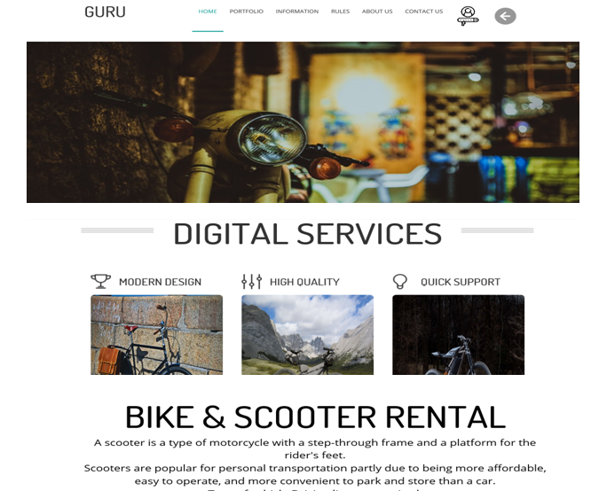
FORM DESIGNING

Slide 21
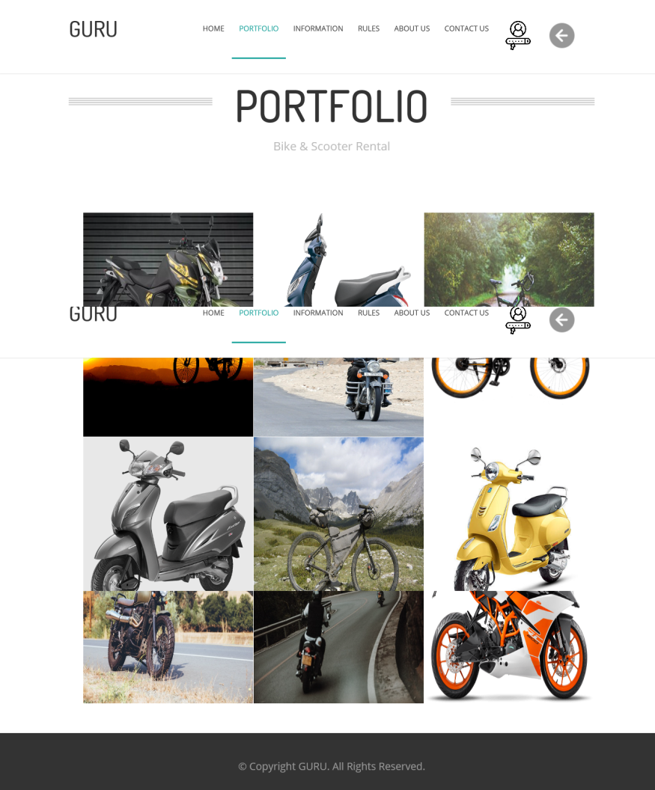

Slide 22
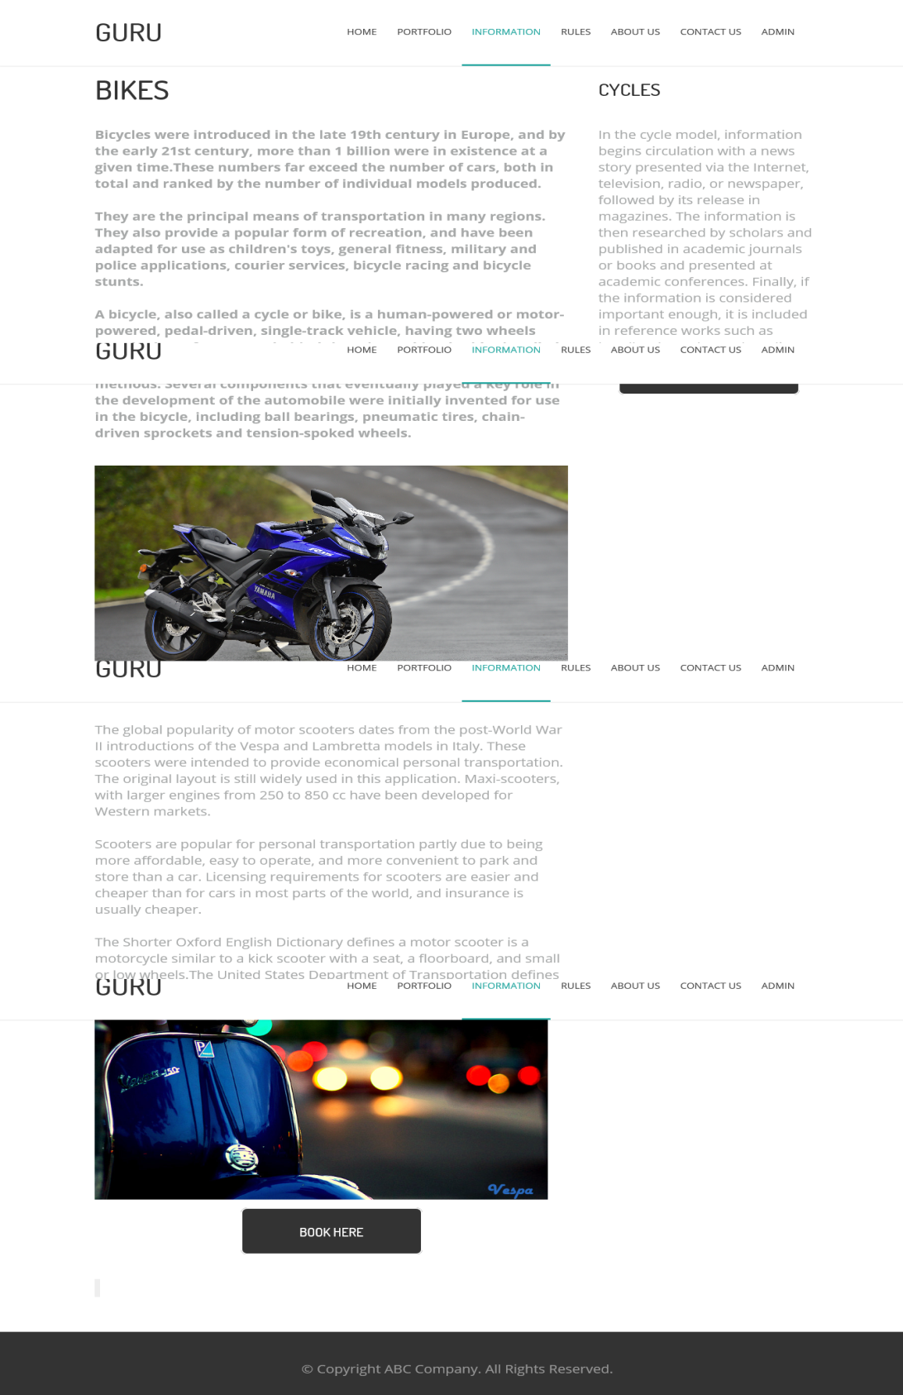

Slide 23
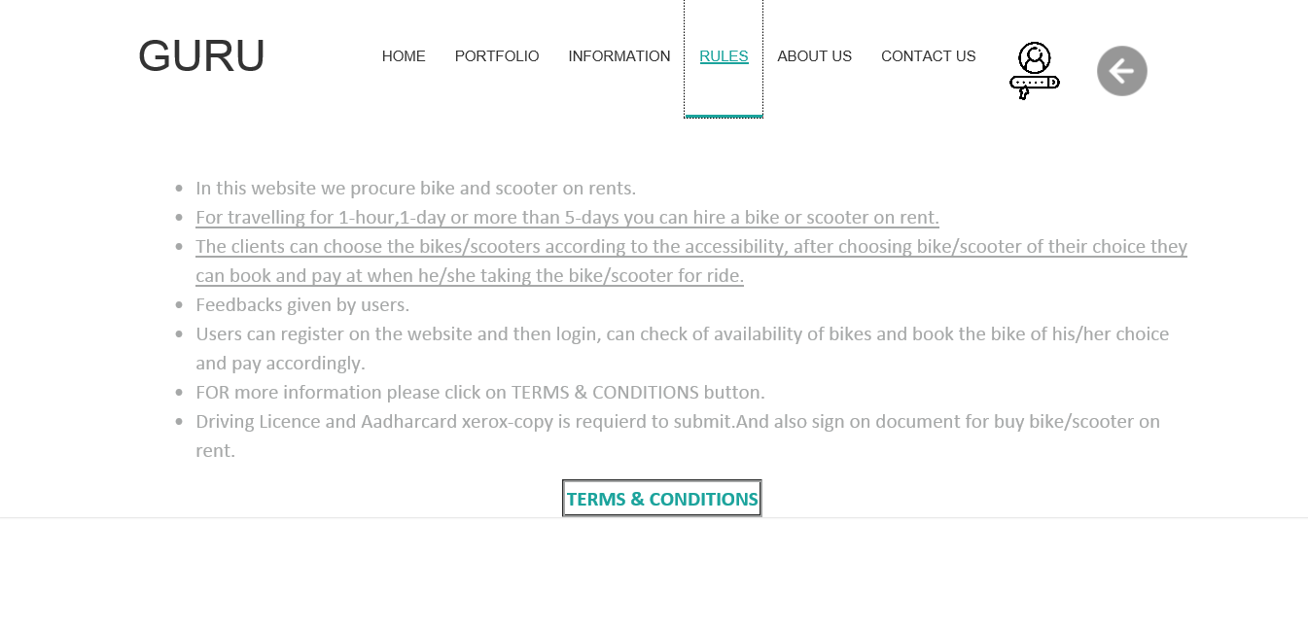

Slide 24
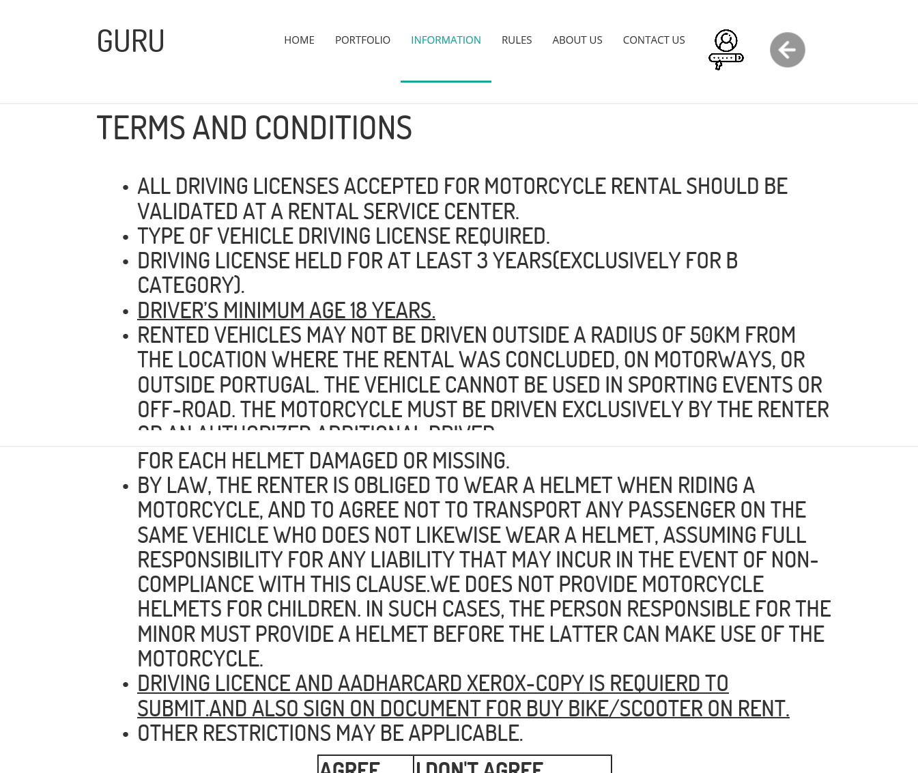

Slide 25
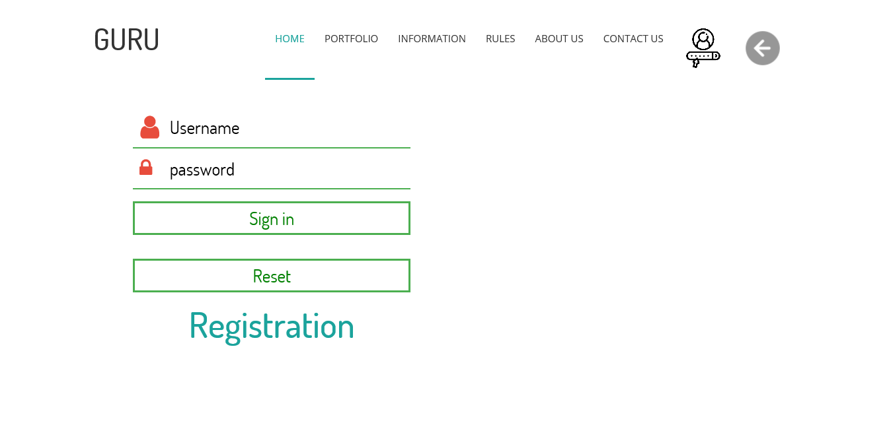

Slide 26
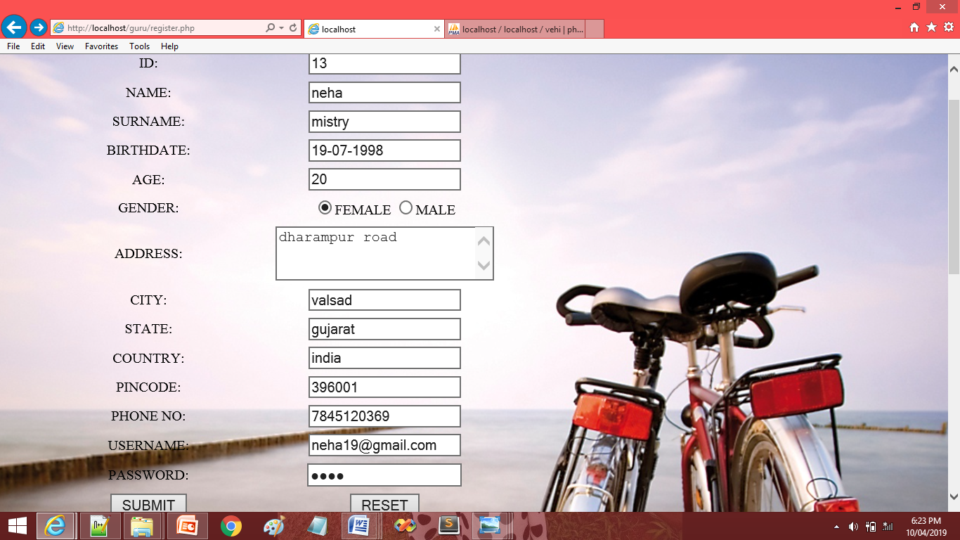

Slide 27
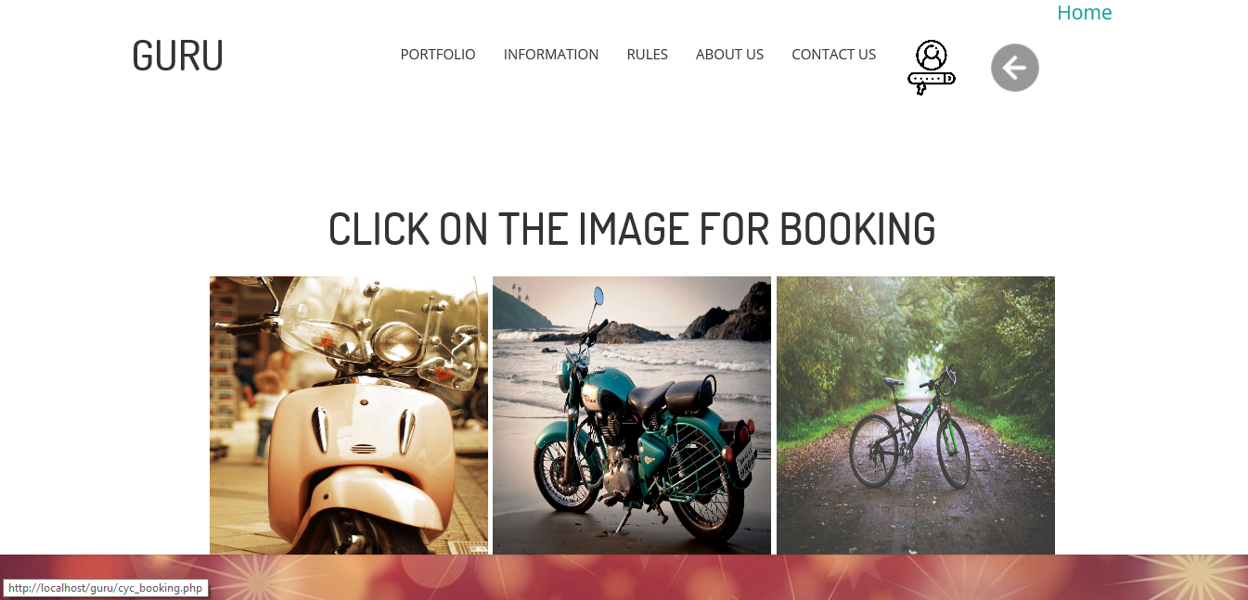

Slide 28
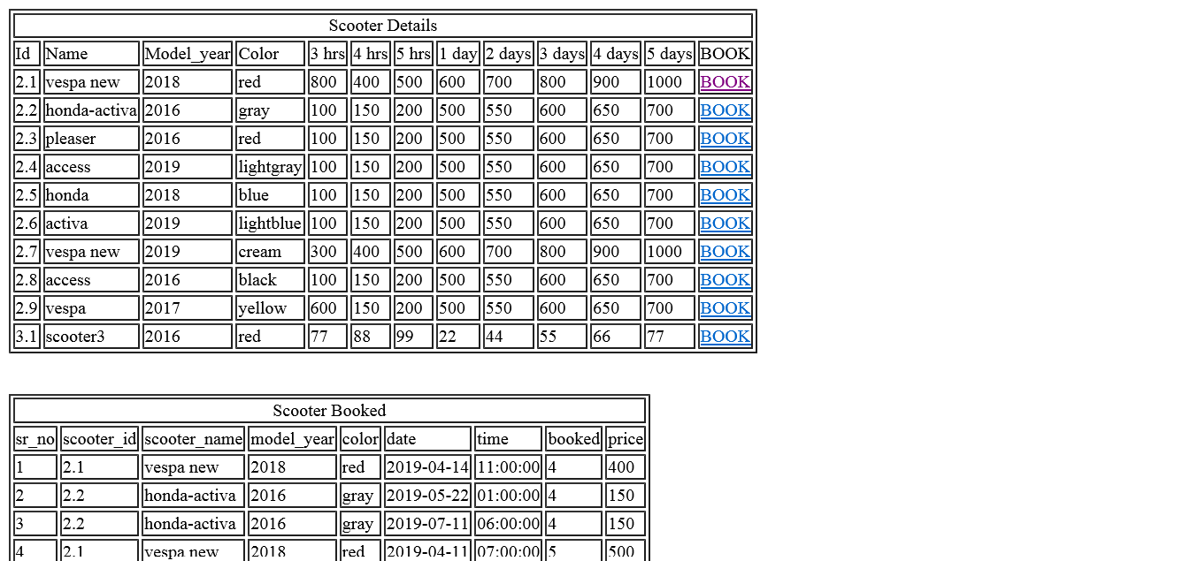

Slide 29
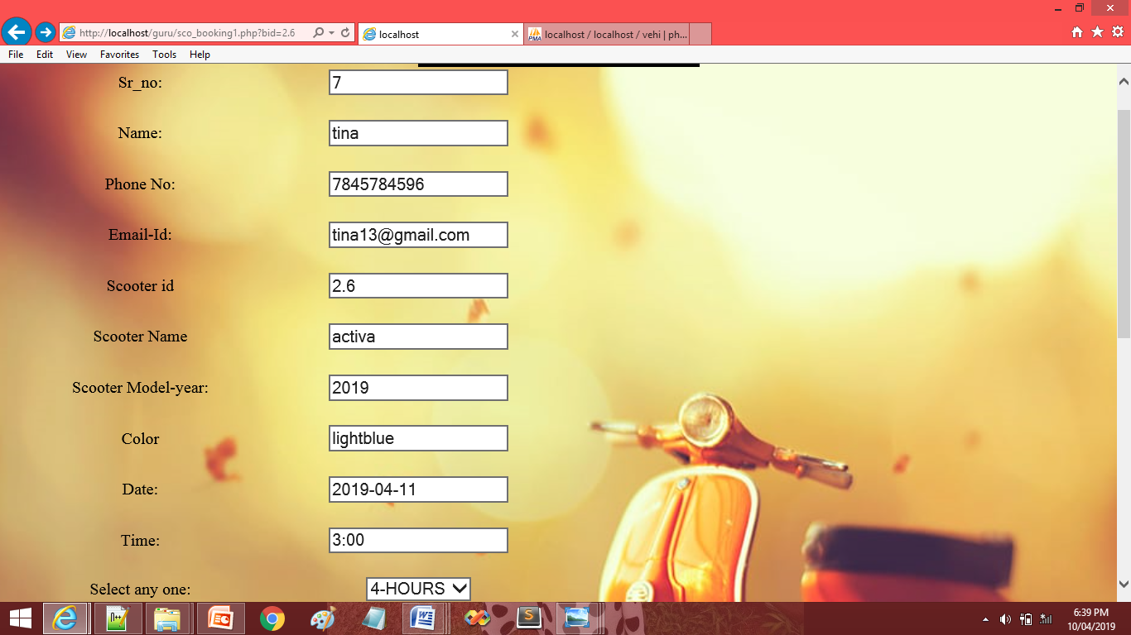

Slide 30
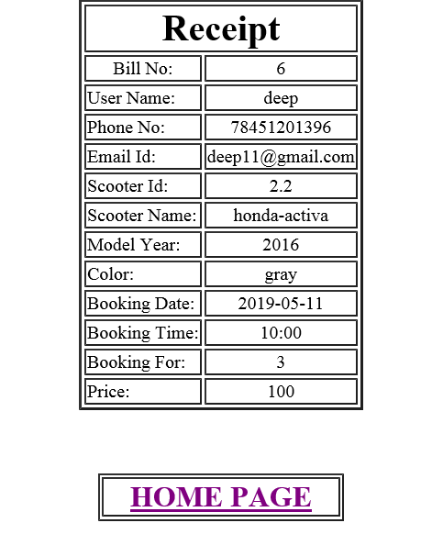

Slide 31
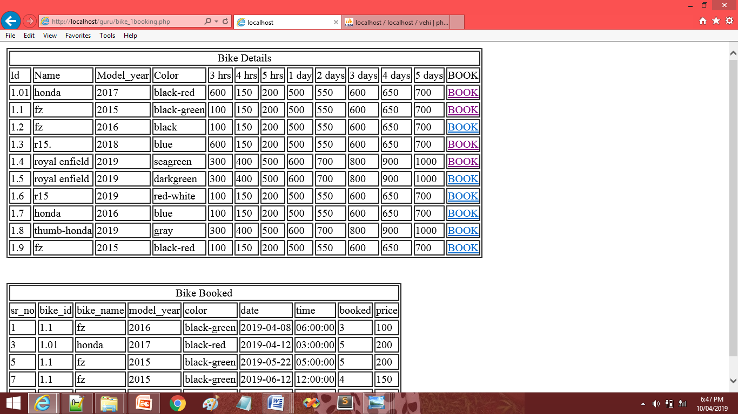

Slide 32
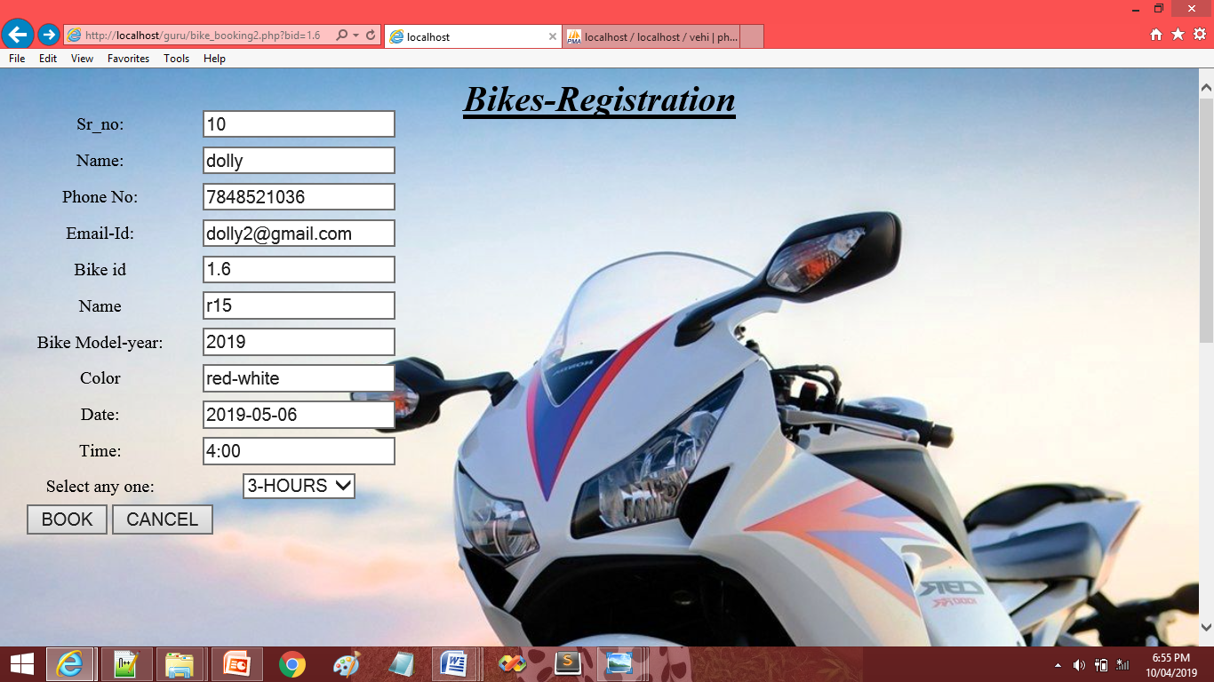

Slide 33
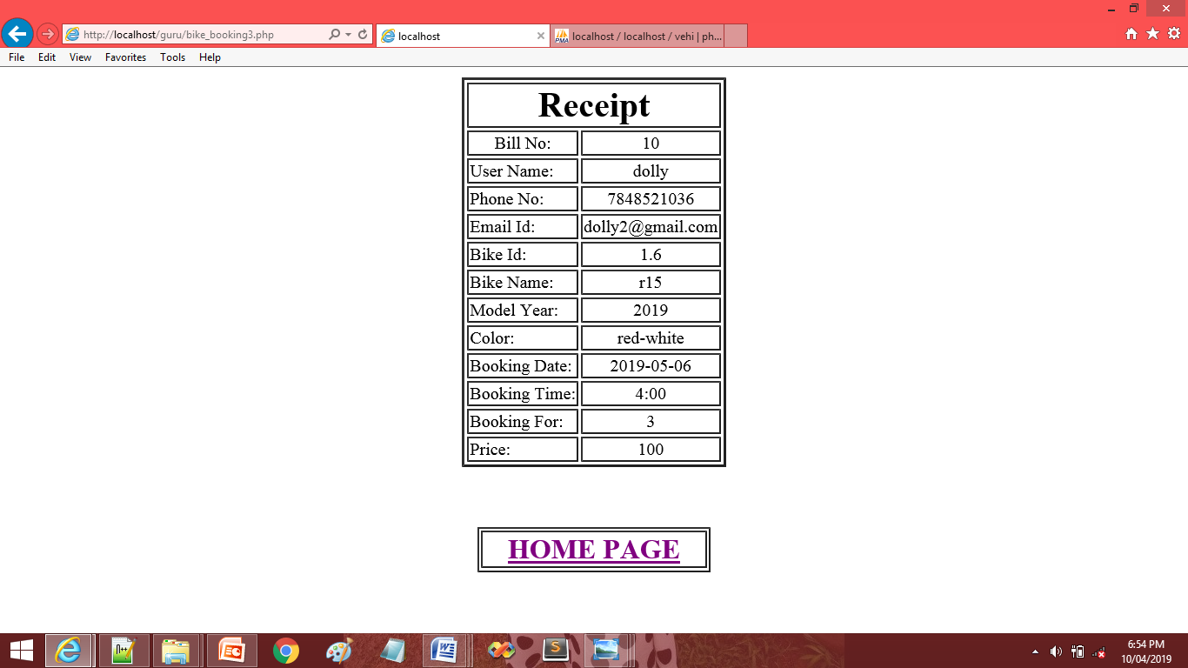

Slide 34
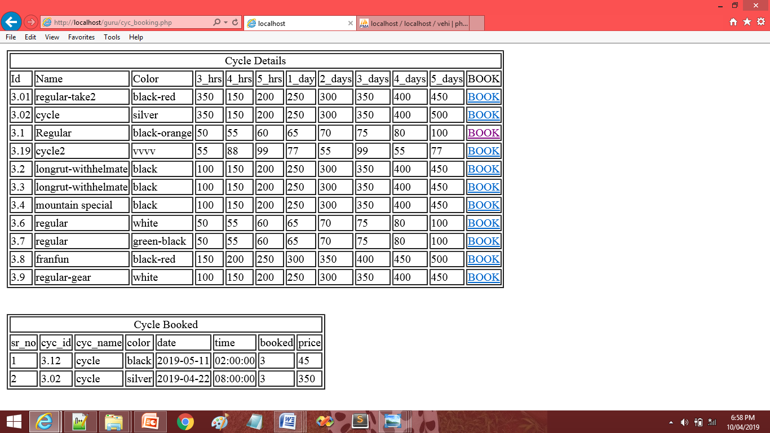

Slide 35
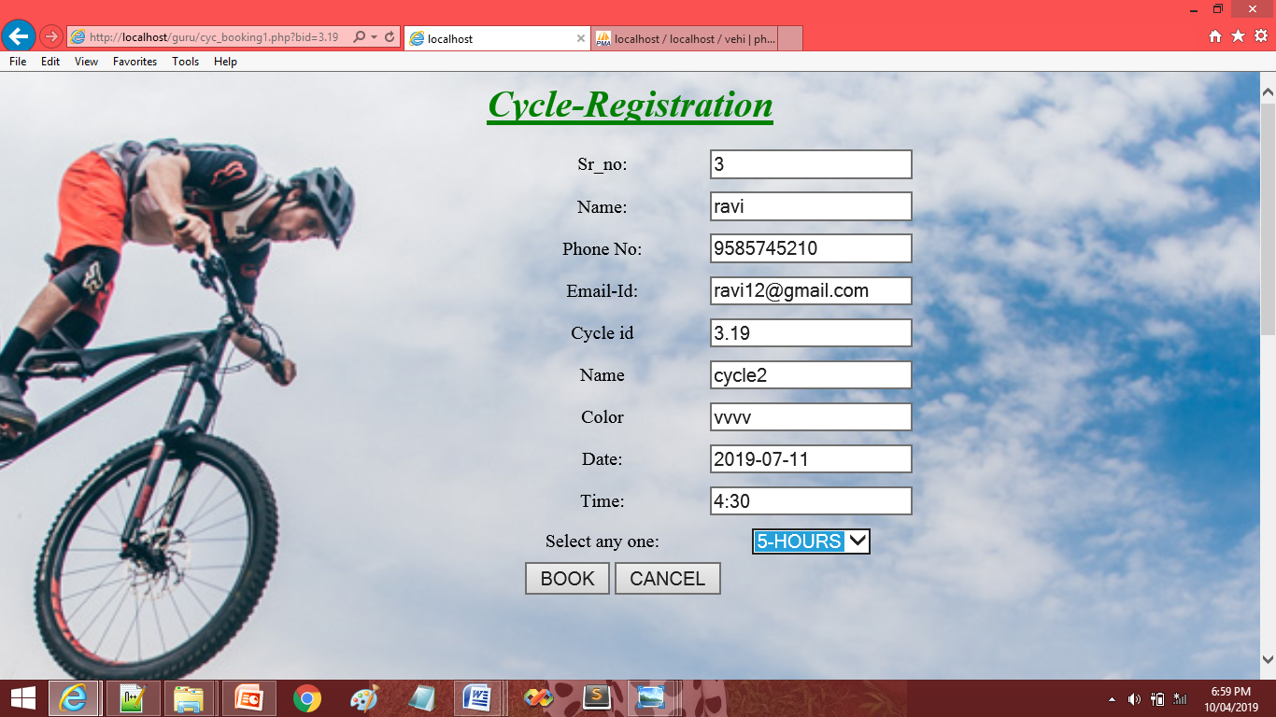

Slide 36
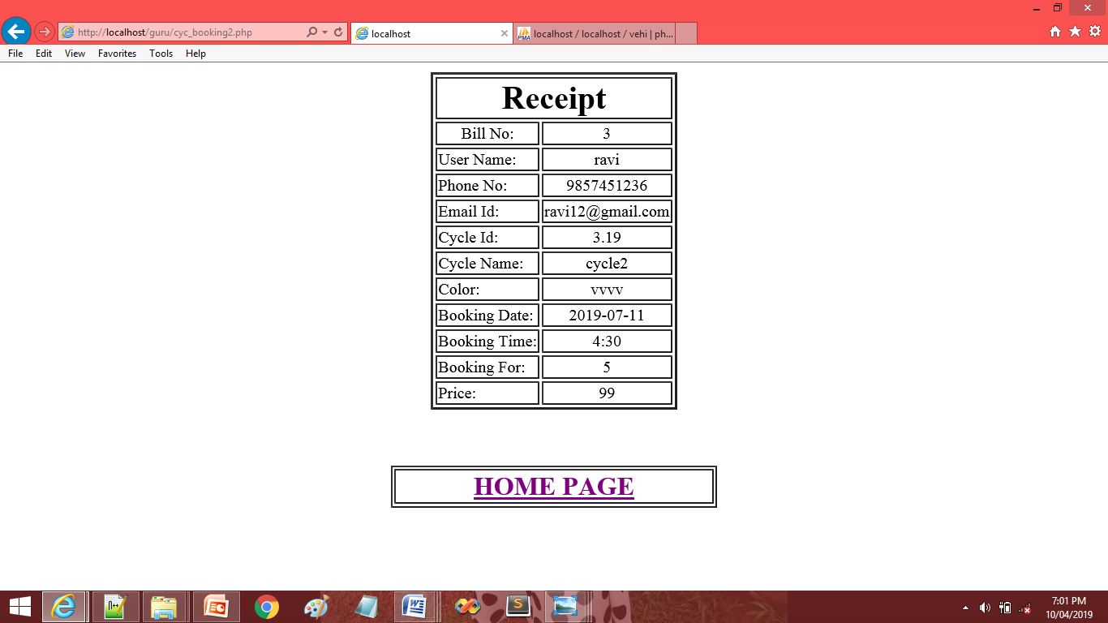

Slide 37
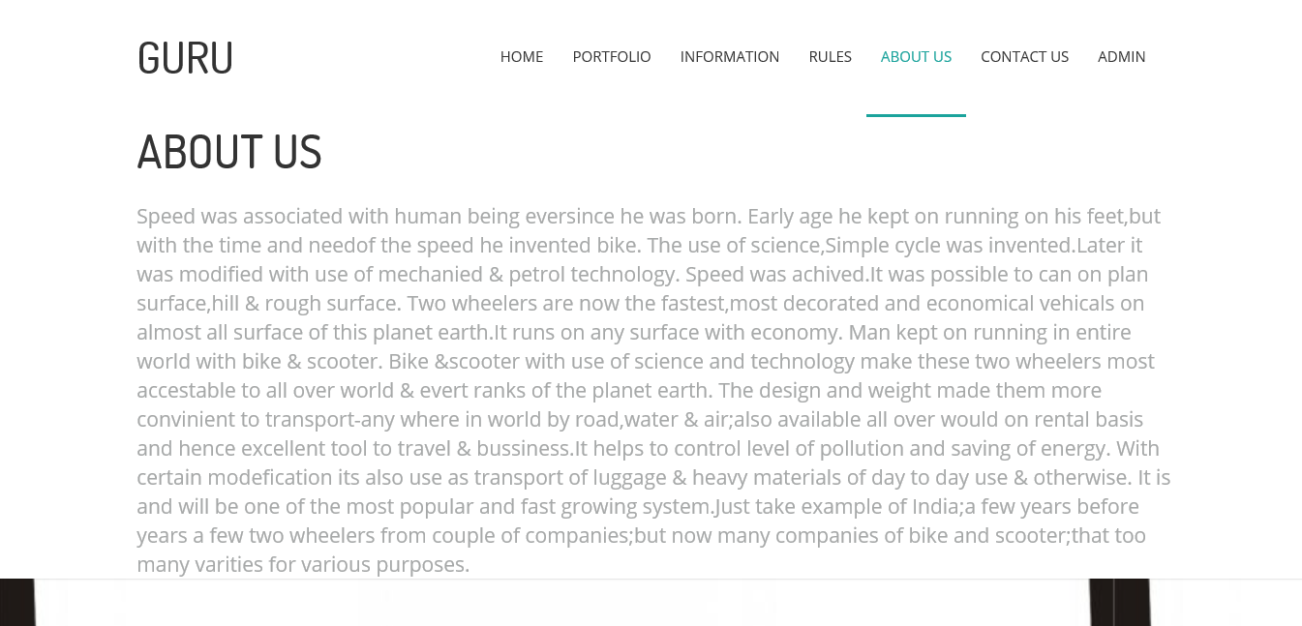

Slide 38


Slide 39
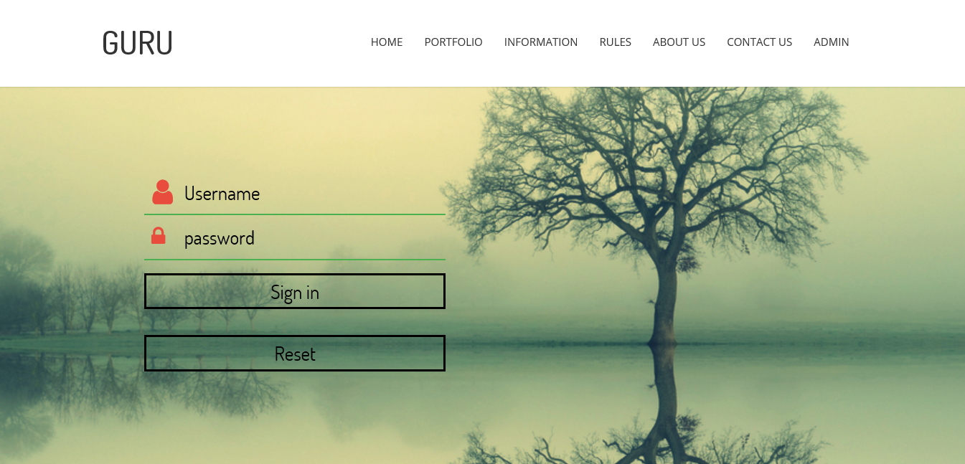

Slide 40
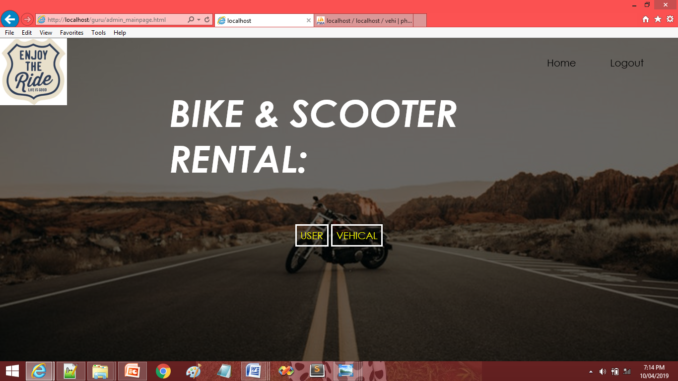

Slide 41
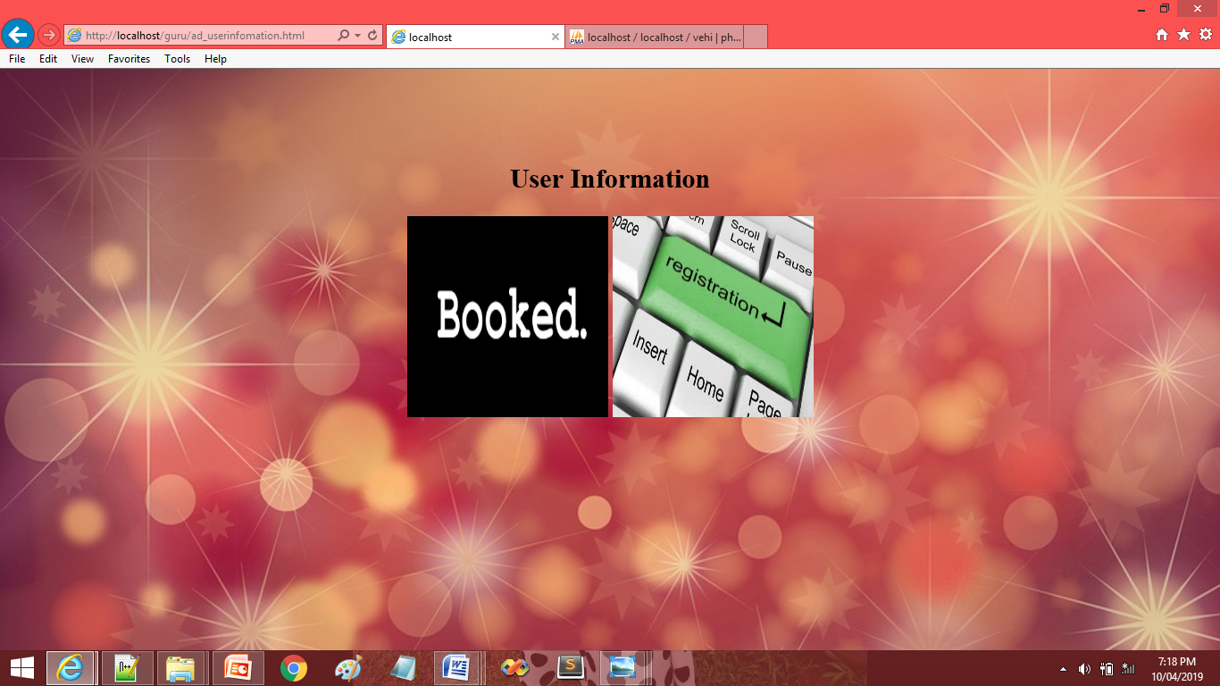

Slide 42
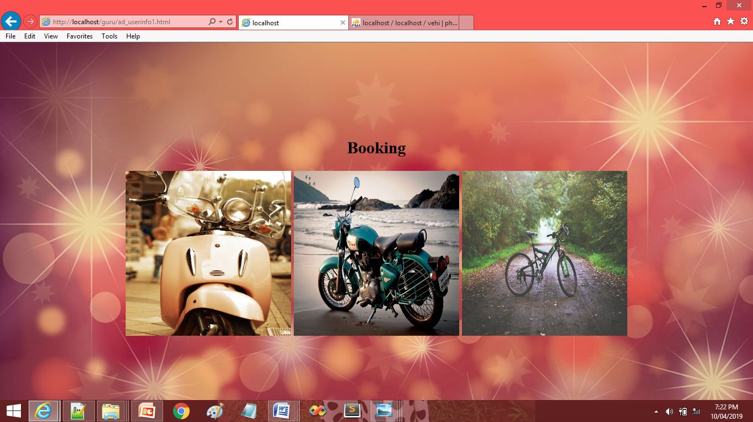

Slide 43
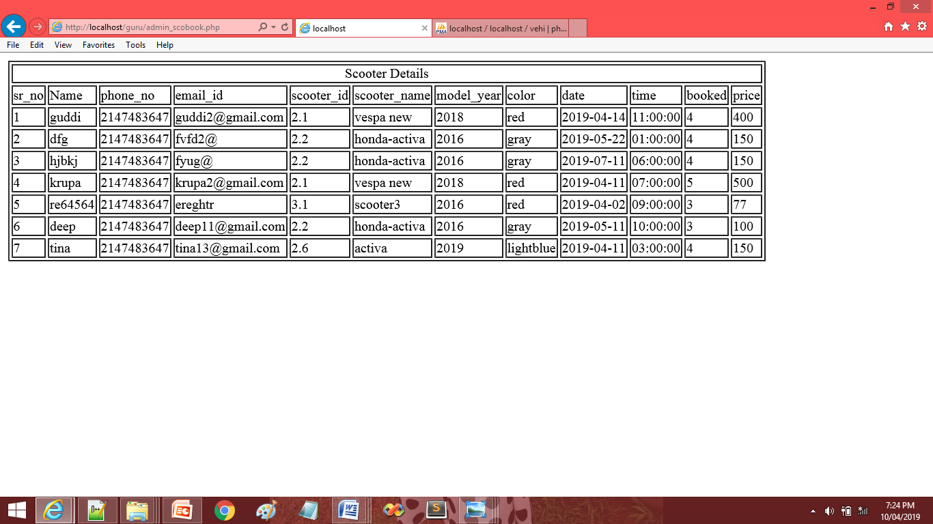

Slide 44
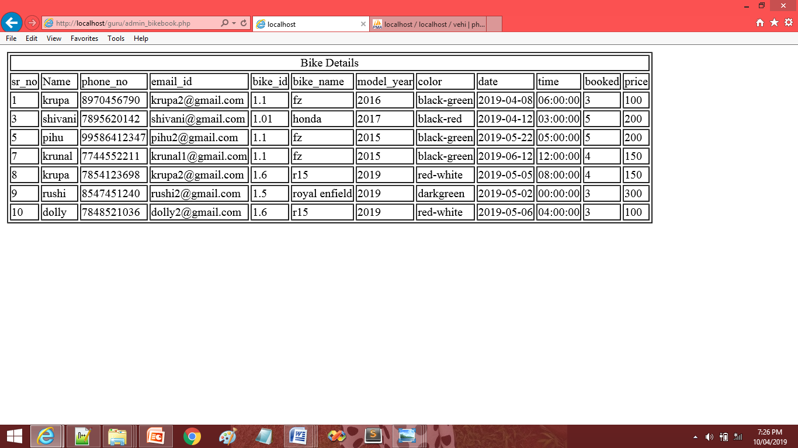

Slide 45
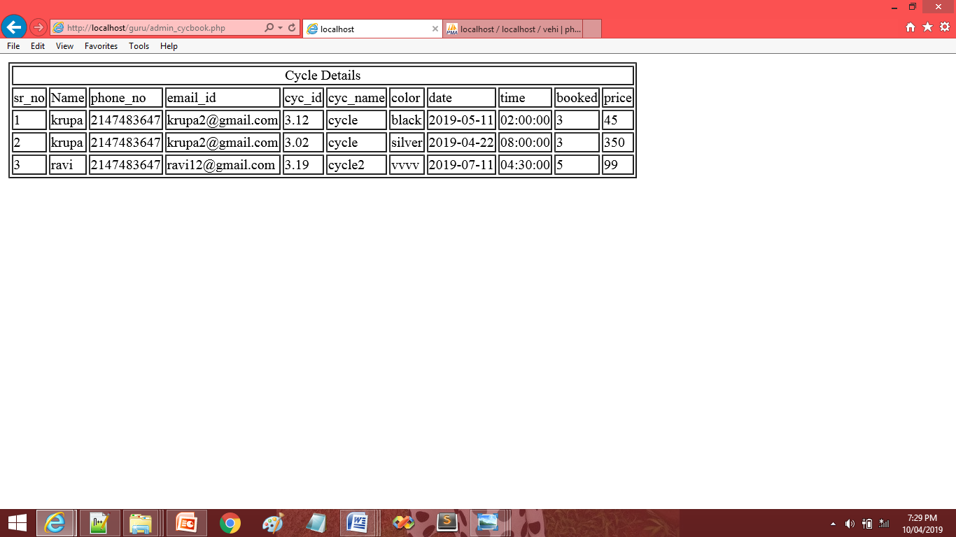

Slide 46
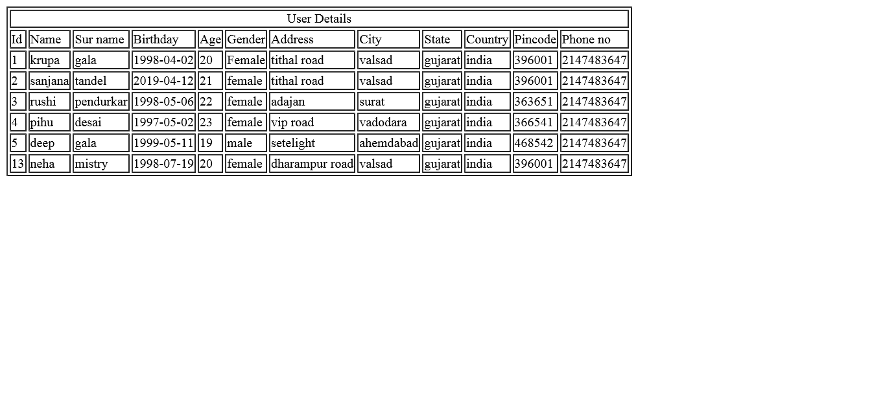

Slide 47
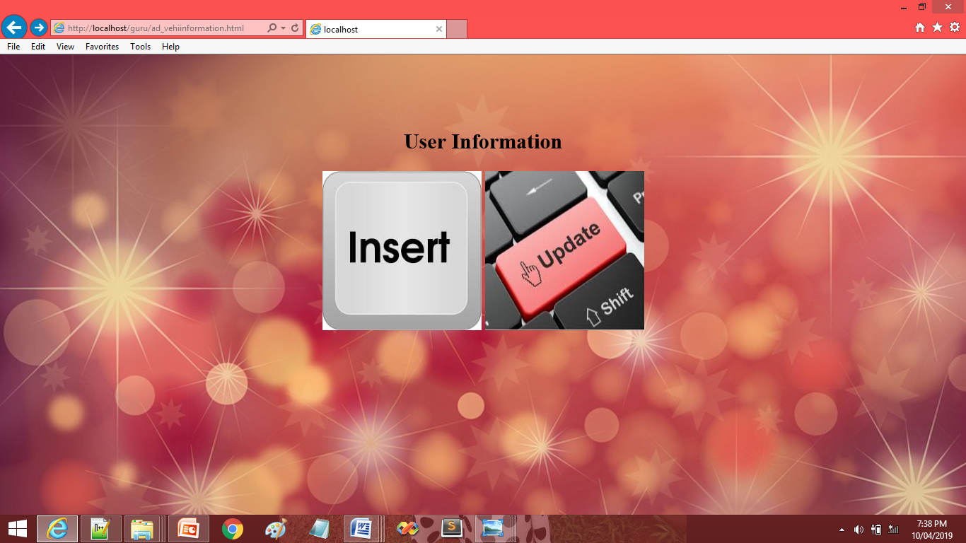

Slide 48
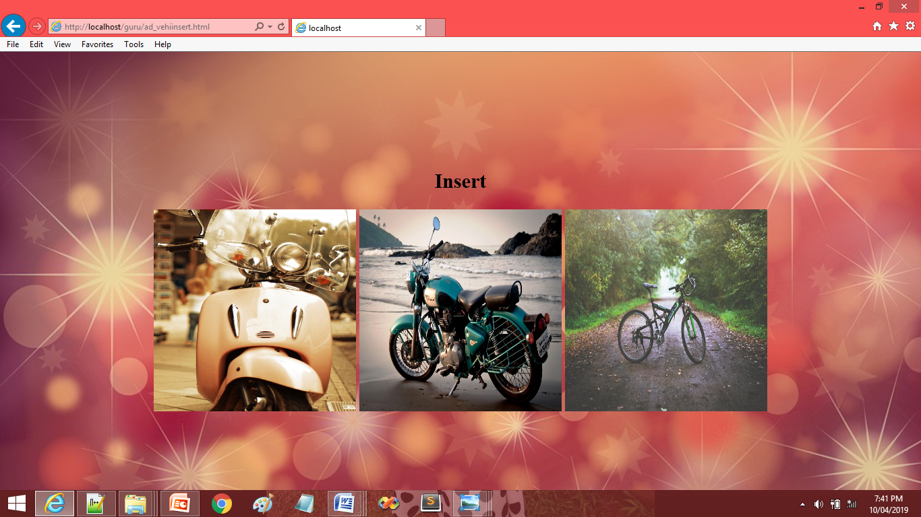

Slide 49
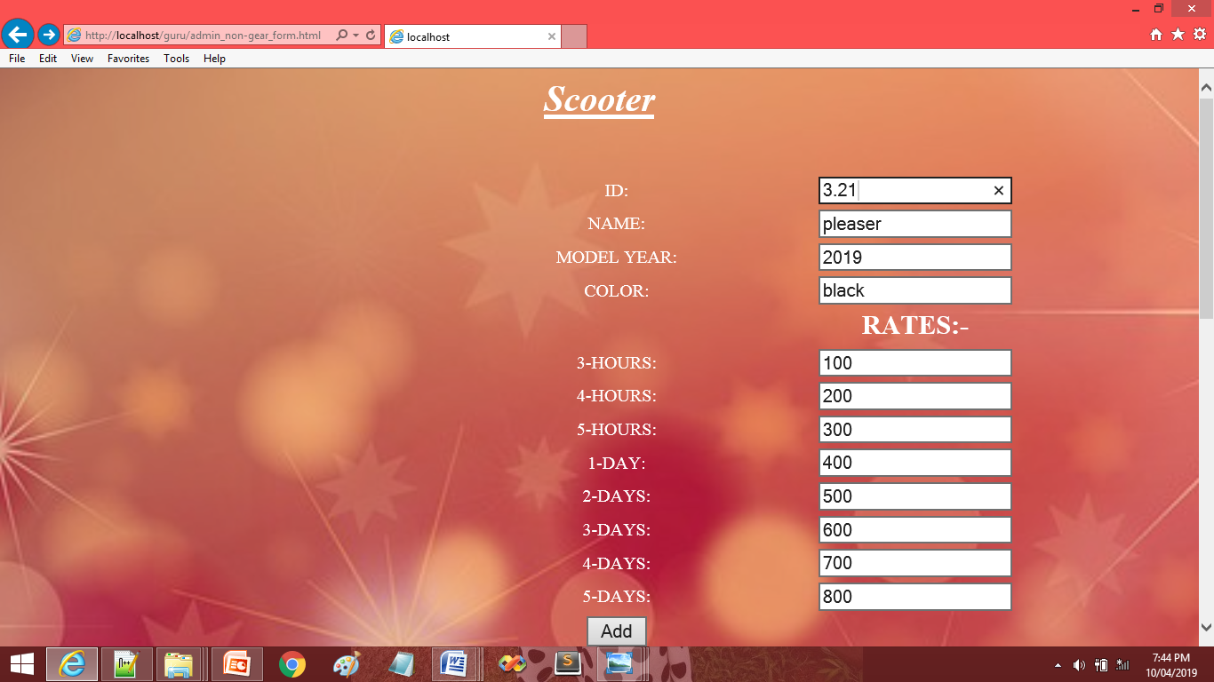

Slide 50


Slide 51
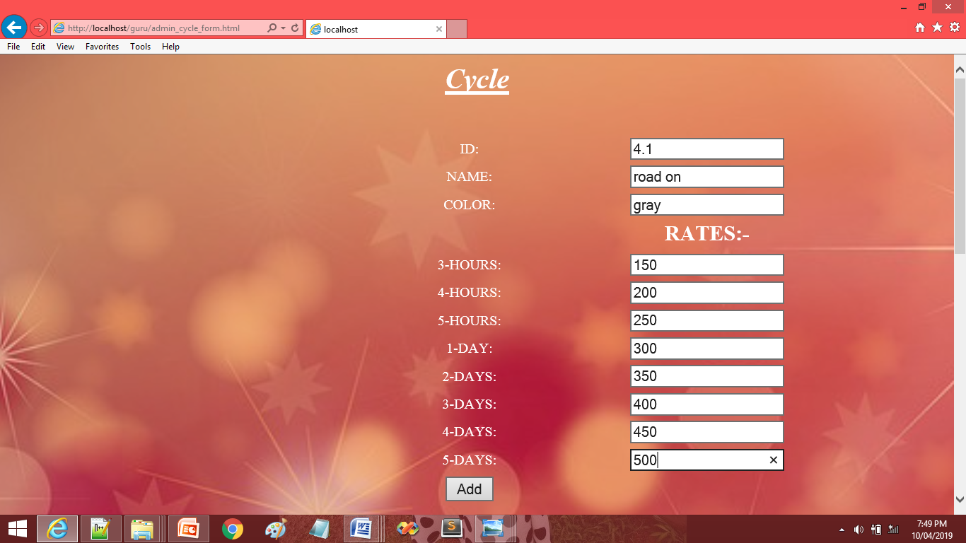

Slide 52


Slide 53
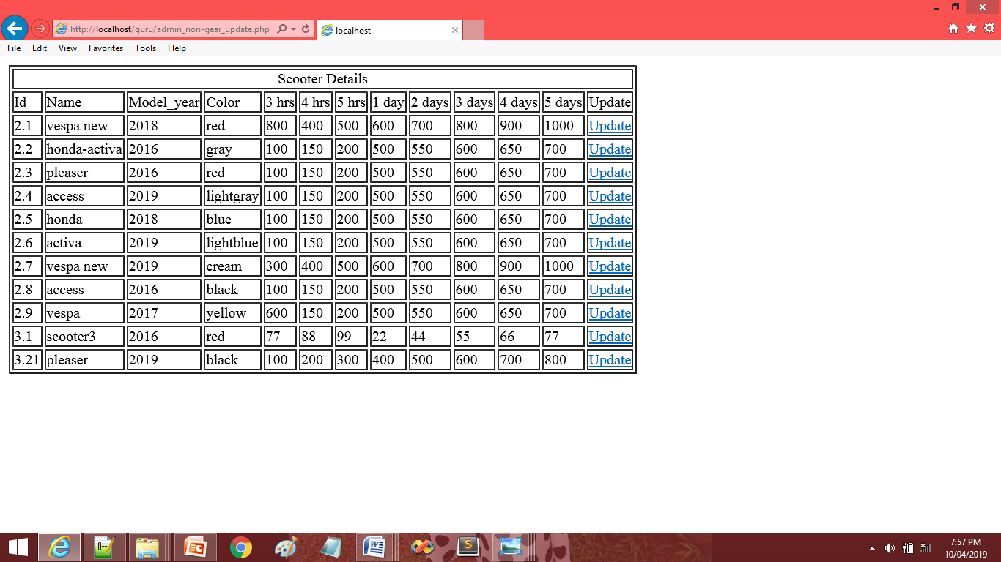

Slide 54
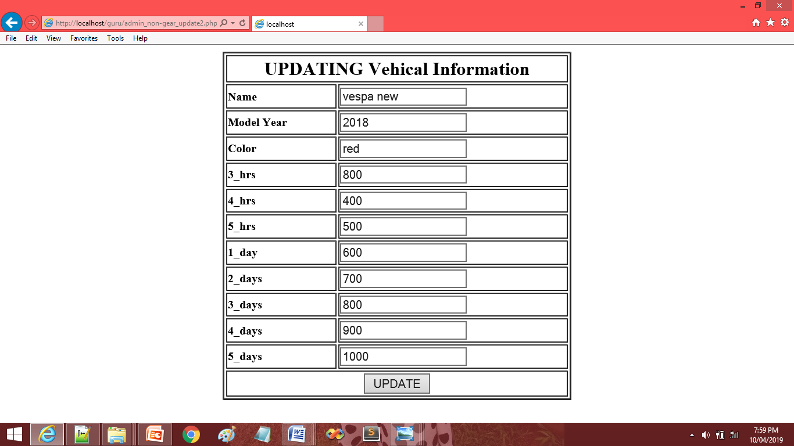

Slide 55
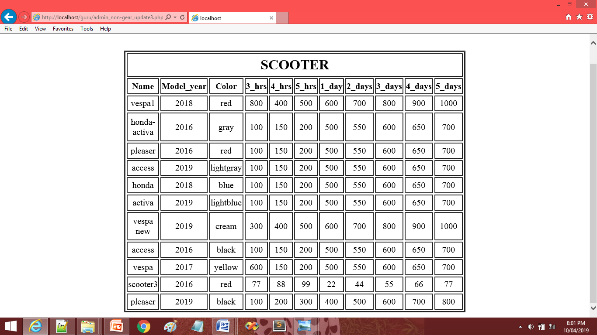

Slide 56
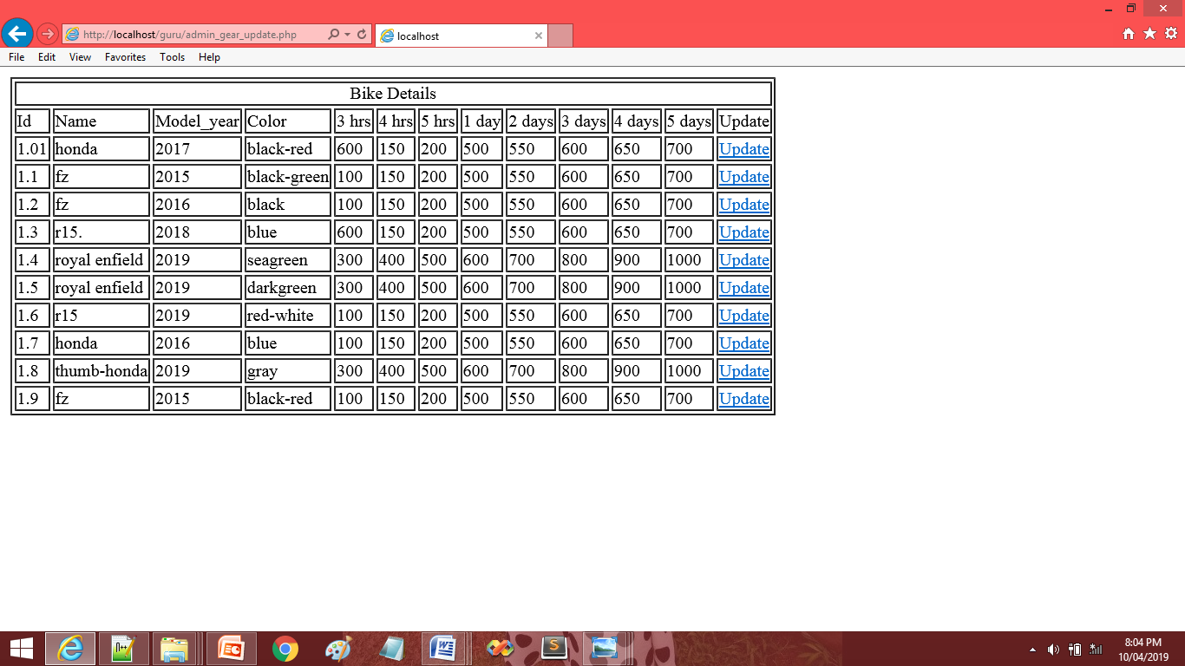

Slide 57


Slide 58
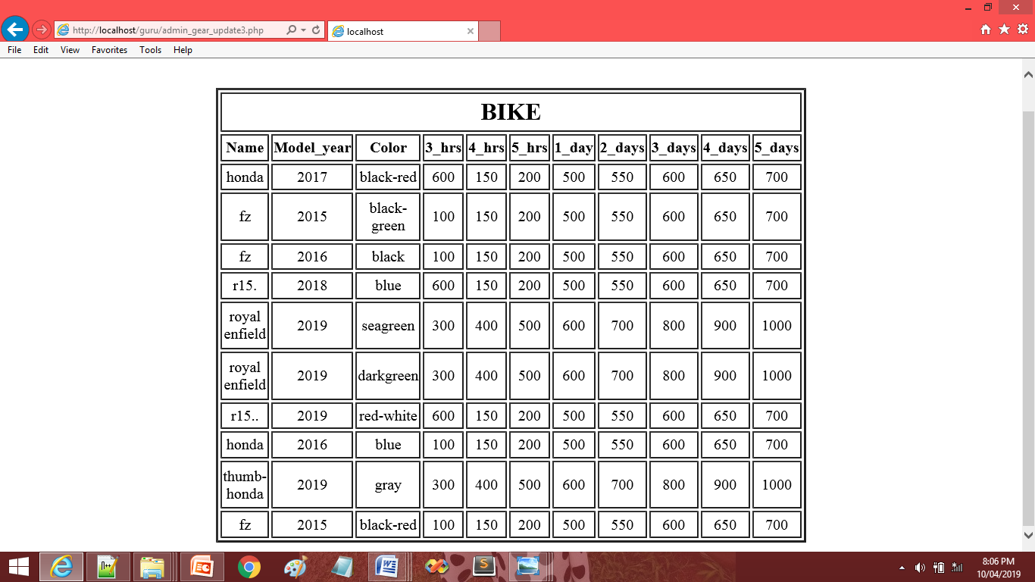

Slide 59
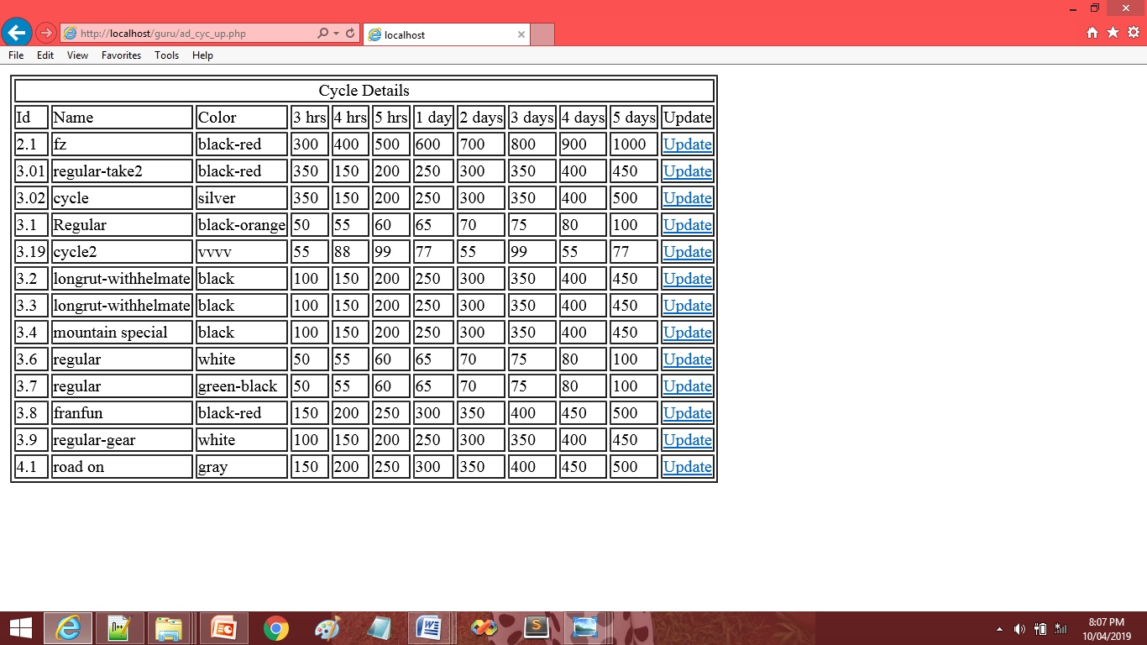

Slide 60
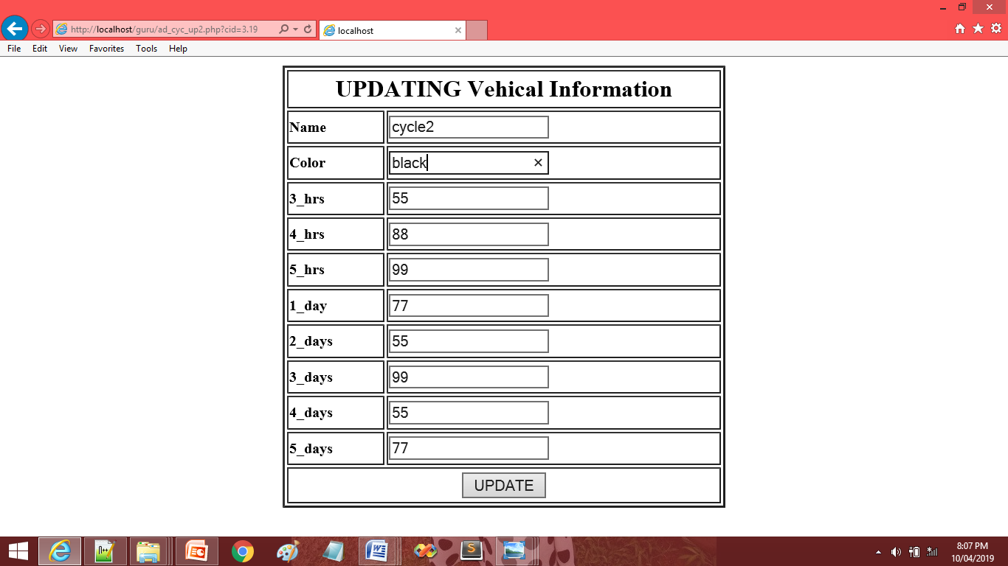

Slide 61
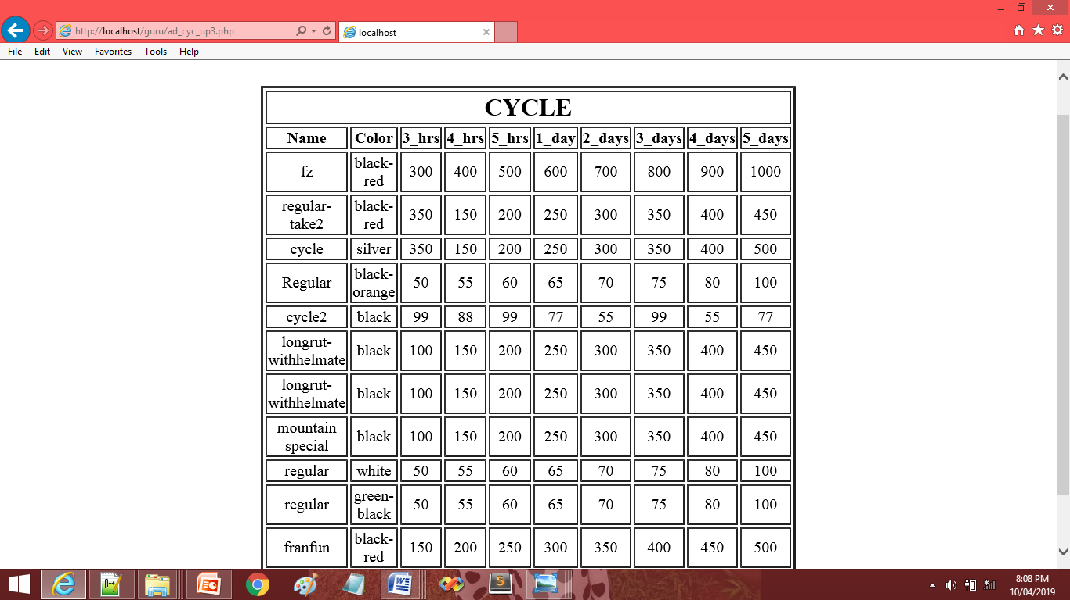

Slide 62
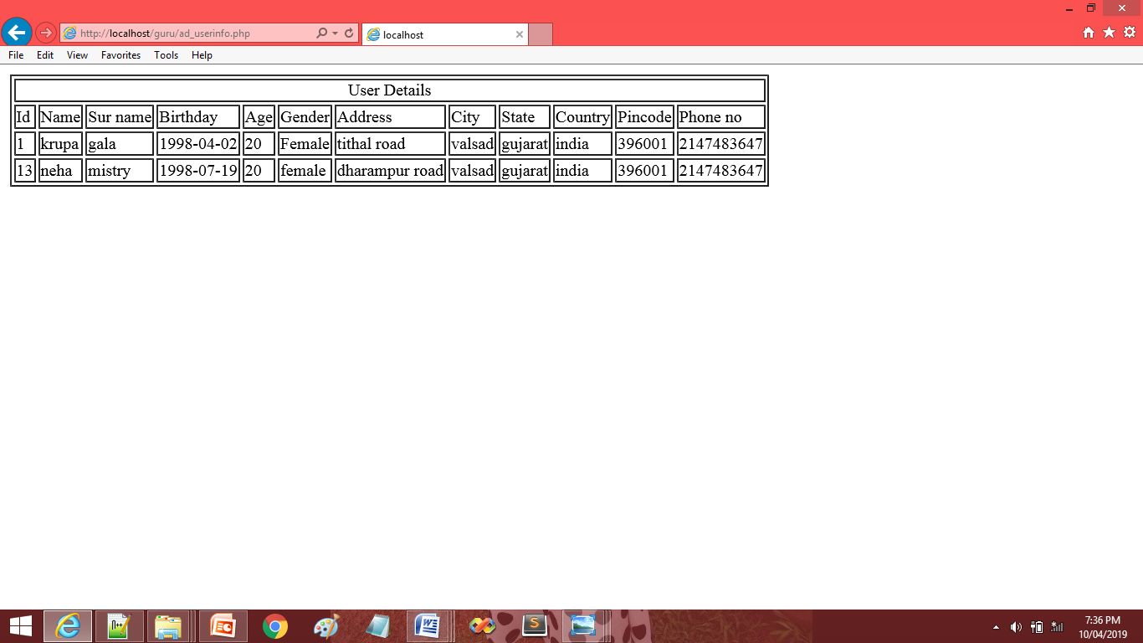
REPORT

Slide 66
CONCLUSION
This software helps the user to rent bikes.
The optimal distribution of bike sharing stations should first of all cover the stops of medium long range transportation modes.
We can say that the most of the station is visible, the more effective is the location.

Slide 67
FUTURE ENHANCEMENT
In future, our application will overcome the flaws if occurred, and attains new features offered to customers for flexible and easy transportation.
Following are the enhancements to the application:-
Providing good user interface
Try to implement the GPS system in the bikes and scooter.

Slide 68
REFERENCES
PHP BLACK BOOK
ESSENCE OF PHP
PHP WITH MYSQL

